Slide 1
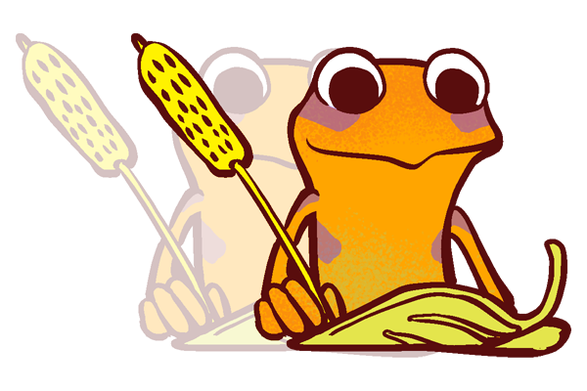
The Doubler

Slide 2
Week One

Slide 3
The Doubbler
Learning Objective:
I can define “the doubler”
I will discuss the importance of journaling my positive experiences.
Notes:
Standard:
Essential Concept and/or Skill: Communicate and work productively with others emphasizing collaboration and cultural awareness to produce quality work.
Interact positively as a team member.
Cooperate with others in a group setting.
Generate ideas with group members.
Are active listeners.
Read and understand information in a variety of forms.
Express ideas.
Skill:
Active listening, express ideas

Slide 4
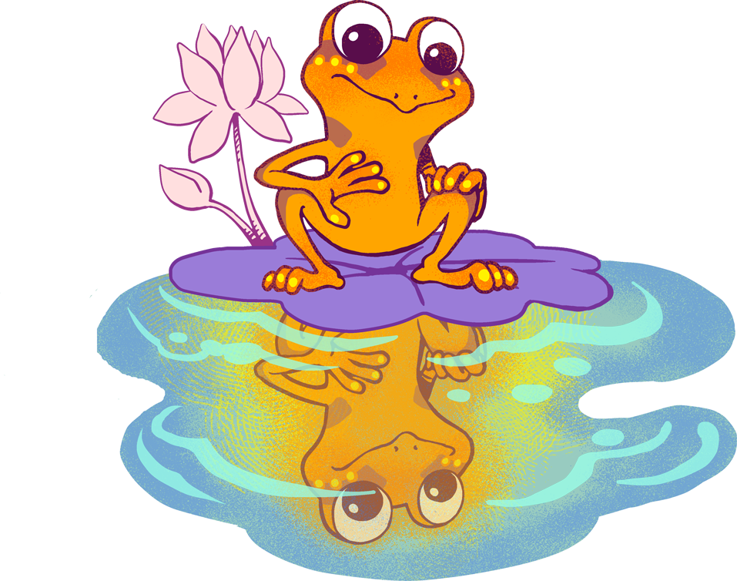
Skills
Communicate clearly
Use information creatively

Slide 6
Journaling
Today we are going to journal a positive experience from the last 24 hours.
When we write out our positive experiences, it tricks our brain to relive the positivity, effectively doubling it. Thus “The Doubler”.
This is going to be a 21-Day challenge. We are going to journal for 21 days, like we did gratitudes.

Slide 7
